Slide 1

&
TheBoys

Slide 2

Problem Statement
Help people to find nearby CHAS clinics…
Notes:
It is important for our project to have a concise description of the issue that needs to be addressed by the team before we try to solve the problem.
CHAS Explorer wants to help people to find nearby CHAS clinics…
And using a mobile application, we hope people can easily identify and locate the clinics covered under CHAS.

Slide 3




Requirement Elicitation
Requirement Analysis
Design & Implementation
Testing
Notes:
Software Engineering brings us through 4 main phases to resolve our problem statement. Namely, REQUIREMENT ELICTATION, REQUIREMENT ANALYSIS, DESIGN/IMPLEMENTATION and lastly TESTING.

Slide 5



Requirement Elicitation
Notes:
In Requirement Elicitation we place ourselves in the shoes of our stakeholder to obtain information that needs to be dealt with.

Slide 6
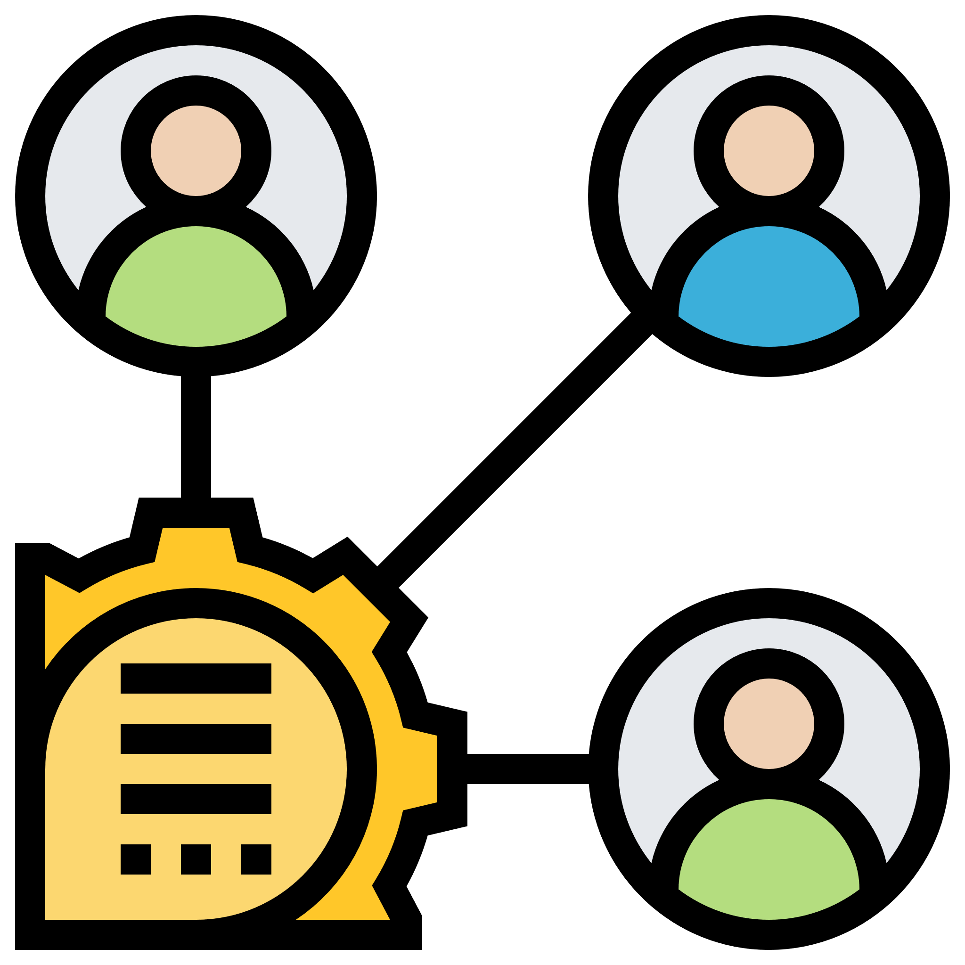
Who?
Stakeholders
Clinic Patient
Clinic Staff
Developer
Tester
Notes:
First we identify the stakeholders, and asking ourselves, we identify the clinic patient and clinic staff as the 2 most important stakeholders.

Slide 7

What?
Identify required features
Find needs of the stakeholders
Examine existing mapping services
Notes:
Next we think of what features are required and also the needs of the stakeholders.
We also examine existing solutions similar to our app.

Slide 8
How?
Functional Requirement
Non-functional requirement
Use Case
Data Dictionary
UI Prototype
Notes:
We do so by identifying the requirements, use cases and UI prototype

Slide 9





Required Features
Search clinics by name
View all clinics in map view
View all clinics in list view
View clinic information in detail
Upload reviews for clinic
Notes:
Through these steps we figure out the required features as shown on screen.

Slide 10

Requirement Analysis
Notes:
After eliciting requirements through the various methods applied, we analyse the information to lay the ground for the Design & Implementation

Slide 11



Actors
User
Google
Data.gov.api
Notes:
Before we dive into the conceptual models, we will go through the use case models to aid in the analysis.

Slide 12
Cases
Search Clinic
Notes:
To avoid overwhelming you guys we will only focus on the most important Use Case (SEARCH CLINIC).

Slide 13
Use Case Model
Search Clinic
wants to
User
Notes:
Lastly we match the actors to the use cases. In our most important use case scenario, the user must be able to search a clinic.

Slide 14
Use Case Model
Search Clinic
wants to
provide data
Data.gov.api
User
Notes:
The particular clinic has to have its data provided by GOV API.

Slide 15
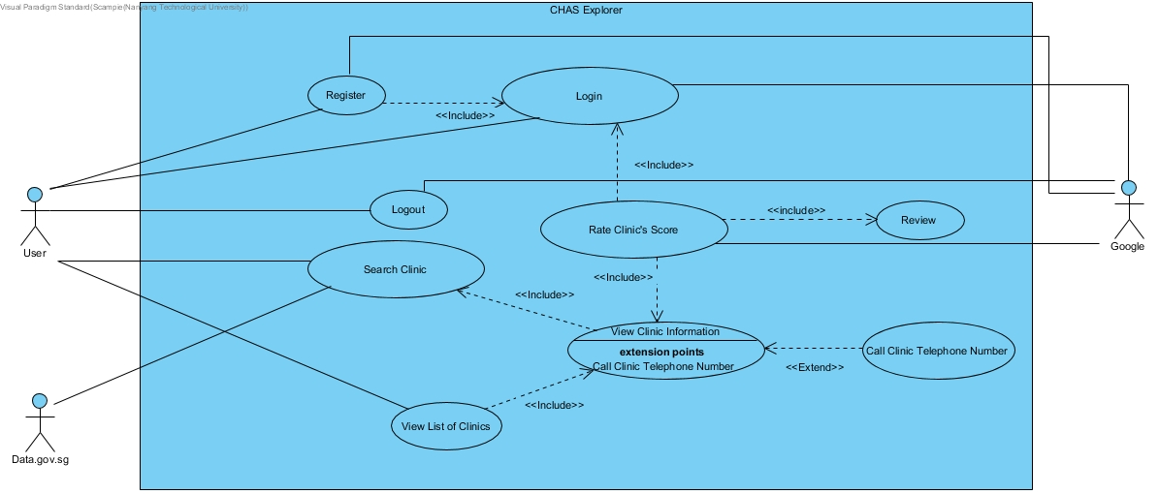

Slide 16
Conceptual Model
MapUI
ClinicUI
MapController
ClinicController
Clinic
Notes:
For us to complete the (SEARCH CLINIC) use case scenario the User should be able to do so in the MapUI & ClinicUI boundary classes.
The respective control classes will be accessed before information can be retrieved from the Clinic entity class.
Note MapController shares a dependency relationship with ClinicController such that MapUI can still access the Clinic entity class. With this model, low coupling and high cohesion is enforced

Slide 17
Conceptual Model
<<entity>>
Clinic
-clinicCode : String
-clinicName : String
-licenseType : String
-clinicTelNo : String
-postalCode : int
-addrType : int
-blkHseNo : String
-floorNo : String
-unitNo: String
-streetName : String
-buildingName : String
-programmeCode : String
-XCoordinate : double
-Ycoordinate : double
-incCrc : String
-fmelUpdD : String
+CREATOR : ParcelCreator<Clinic>
+constructors()...
+getters()...
+setters()...
Clinic
Notes:
While a boundary class diagram does not show the entire picture of the model, an entity class diagram shows the in-depth view of the classes.

Slide 18
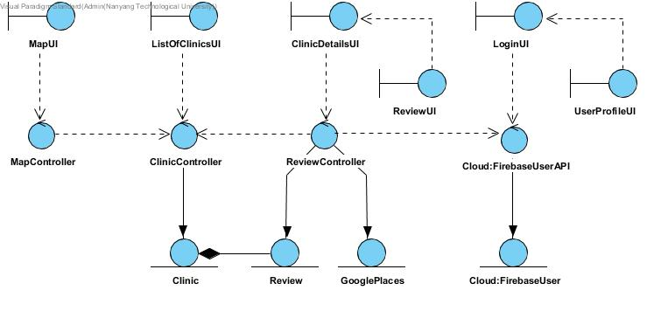

Slide 19
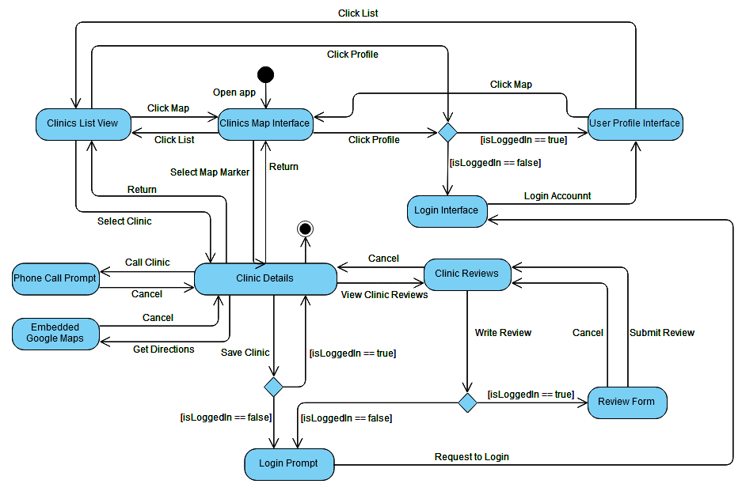
Dynamic Model
Notes:
With our conceptual model done, we deduce the various behavioural states and changes through our dynamic model.
The state diagram helps us to ensure that the program changes according to plan when developing the different modules for it.

Slide 20
Design
&
Implementation

Slide 21
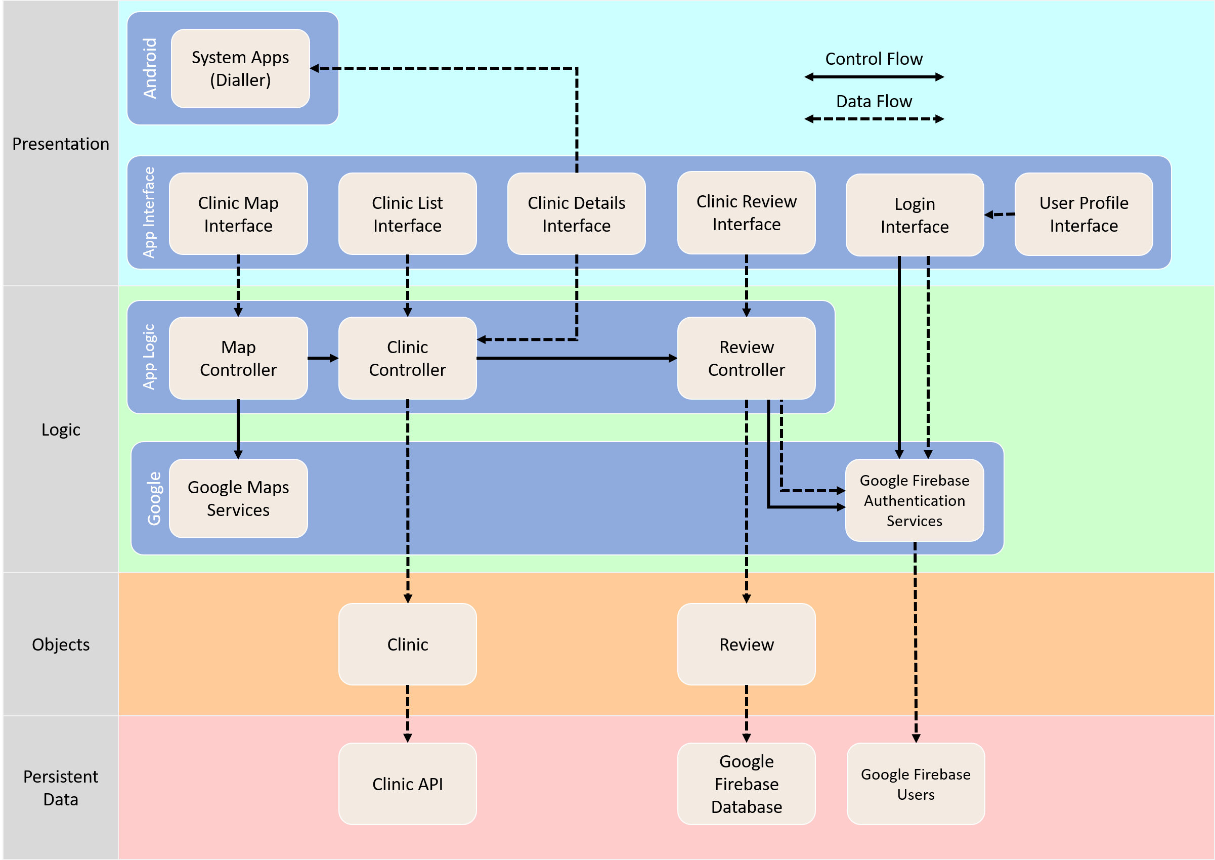
System Architecture
Notes:
We decide to proceed with a layered architecture as it has its advantages.
We do so by separating the user interface from the application logic, and the application logic from data access logic.

Slide 22


Advantages
Loose Coupling
Modularity
Notes:
Through a layered approach, it enables loose coupling between the various modules.
This way the application is also modular and can be independently developed, deployed and maintained.

Slide 23





APIs Used
Notes:
We decide to focus on developing an Android application using Java and XML as our front-end.
Along with Android, we used various Google APIs to develop our application:
Google Maps -> for the geographic maps and location.
Google Identity -> for logging in with Google
Google Places -> for loading clinic details (e.g. opening hours)
To handle our backend needs, we utilised the Firebase cloud platform.
This helps to reduces the hassle of tinkering and setting up a conventional database and backend logic.

Slide 24
Demo
Notes:
We decide to focus on developing an Android application using Java and XML as our front-end.
Along with Android, we used various Google APIs to develop our application:
Google Maps -> for the geographic maps and location.
Google Identity -> for logging in with Google
Google Places -> Details for clinic (e.g. opening hours)
To handle our backend needs, we utilised the Firebase cloud platform.
This helps to reduces the hassle of tinkering and setting up a conventional database and backend logic.

Slide 25
Testing

Slide 26
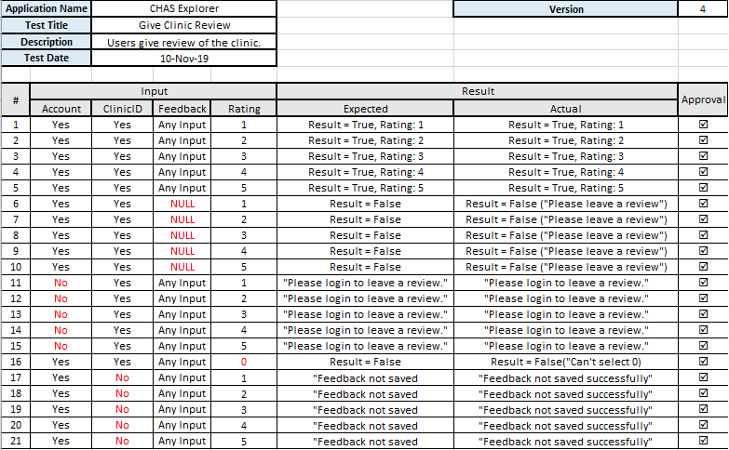
Blackbox Test

Slide 27
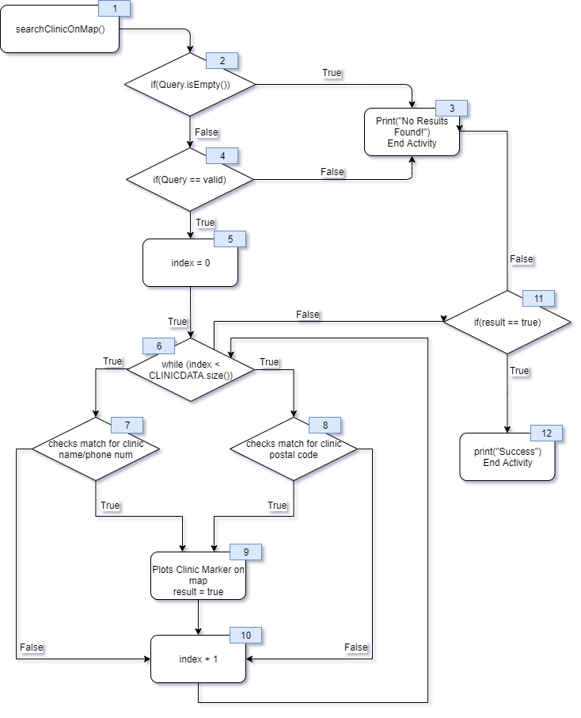
Whitebox Test

Slide 28


Recommendations
Non CHAS clinic support
Crowd density detection
Appointment booking

